Slide 1
Evolutionary Model
Evolutionary model:
The system is broken down into several modules which can be incrementally implemented and delivered.
First develop the core modules of the system.
The initial product skeleton is refined into increasing levels of capability:
by adding new functionalities in successive versions.

Slide 2
Evolutionary Model (CONT.)
Successive version of the product:
functioning systems capable of performing some useful work.
A new release may include new functionality:
also existing functionality in the current release might have been enhanced.

Slide 3
Evolutionary Model (CONT.)
C
A
A
A
B
B

Slide 4
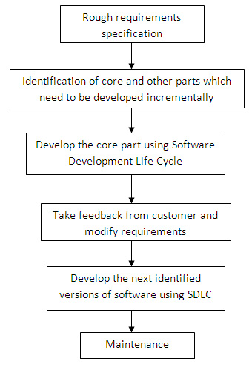

Slide 5
Advantages of Evolutionary Model
Users get a chance to experiment with a partially developed software
much before the full working version is released
Helps finding exact user requirements:
much before fully working system is developed.
Accurately elicit user requirements with help of feedback obtained on delivery of different versions of software
Change requests after delivery of complete software substancially reduced
(Core modules get tested thoroughly:
reduces chances of errors in final product)

Slide 6
Disadvantages
Feature Division into incremental parts
Small-sized Projects: Difficult to divide required features into several parts that can be incrementally implemented and delivered.
Larger sized Projects: Expert would need considerable effort to plan incremental activities
evolutionary model is useful for moderate sized problems
Ad Hoc Design: At design time, only current increment is done.

Slide 7
Evolutionary Model with Iteration
Many organizations use a combination of iterative and incremental development:
a new release may include new functionality
existing functionality from the current release may also have been modified.

Slide 8
Evolutionary Model with iteration
Several advantages:
Training can start on an earlier release
customer feedback taken into account
Markets can be created:
for functionality that has never been offered.
Frequent releases allow developers to fix unanticipated problems quickly.

